Slide 1

Voice and Accent

Slide 2

Let's study
What are speech sounds
Vowels Sounds
Consonant sounds

Slide 3
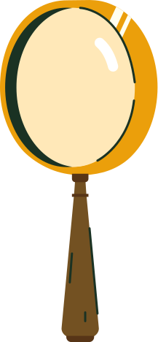
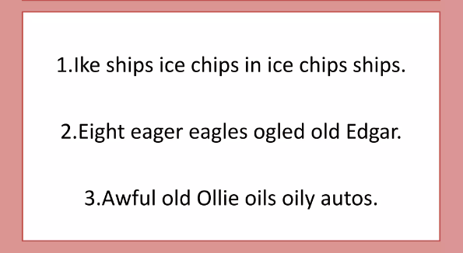
But before we start, try these:

Slide 4
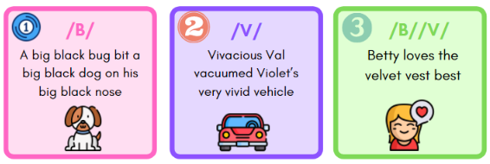
But before we start, try these:

Slide 5
What are speech sounds?
Speech sounds or phonemes are the smallest unit of sound. They are the vocal sounds we use to make up the words of the English language.
In English, the alphabet is made up of 26 letters. However, there are 44 sounds that can be made from these 26 alphabets.

Slide 6
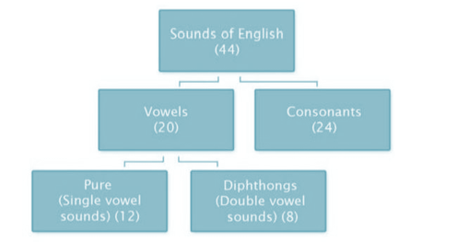

Speech sounds are broadly divided into Vowels and Consonants

Slide 7
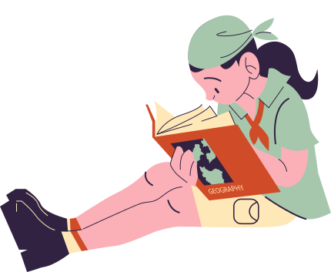


Vowels
Vowels are those sounds during the utterance of which the air escapes freely, without any obstruction.
Monophthongs:
Pure/Single vowel sounds
Diphthongs:
Double/ Combination vowel sounds

Slide 8
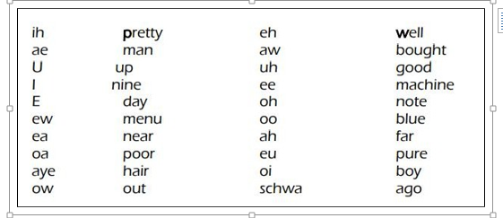
A single vowel in written English gives us multiple sounds in spoken English
20 VOWEL Sounds:

Slide 9
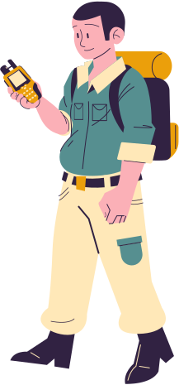


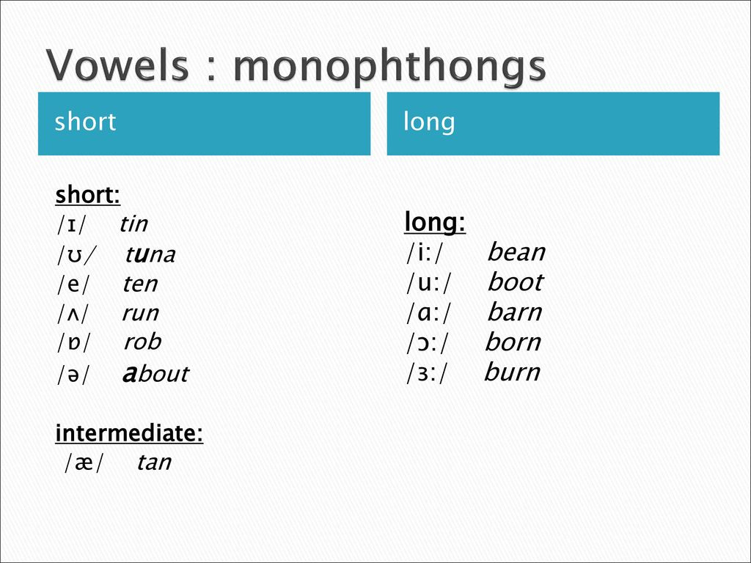
Monophthongs
Monophthongs are short non-gliding vowel sounds. Out of 20 vowels, 12 are monophthongs

Slide 10

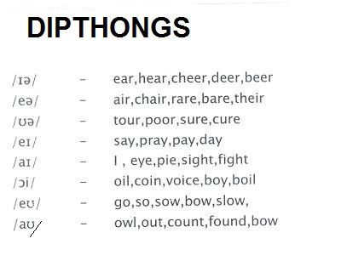
Diphthongs
Speech sound beginning with one vowel sound and moving to another vowel sound within the same syllable

Slide 11
Do the drill:
Drill 1: /i:/ vs. /ɪ/
- Read the following words, focusing on the vowel sound:
- meet /mi:t/ (long "ee")
- bit /bɪt/ (short "i")
- seat /si:t/ (long "ee")
- sit /sɪt/ (short "i")
- Repeat each word 5 times, switching between the long and short "i" sounds
Drill 2: /e/ vs. /ɛ/
- Read the following words, focusing on the vowel sound:
- pet /pet/ (short "e")
- bet /bet/ (short "e")
- play /pleɪ/ (long "a" with a hint of "e")
- plate /pleɪt/ (long "a" with a hint of "e")
- Repeat each word 5 times, switching between the short and long "e" sounds

Slide 12
Do the drill:
Drill 3: /ɑ:/ vs. /ɒ/
- Read the following words, focusing on the vowel sound:
- car /kɑ:/ (long "a")
- cart /kɑ:t/ (long "a")
- cot /kɒt/ (short "o")
- caught /kɒt/ (short "o")
- Repeat each word 5 times, switching between the long and short "a" sounds
Drill 4: /ʊ/ vs. /u:/
- Read the following words, focusing on the vowel sound:
- put /pʊt/ (short "u")
- boot /bu:t/ (long "u")
- foot /fʊt/ (short "u")
- new /nu:/ (long "u")
- Repeat each word 5 times, switching between the short and long "u" sounds

Slide 13
Consonants
Consonants are sounds produced by shaping, stopping or blocking the air stream as it passes through the nose or mouth via the vocal tract. The position of the articulators affect the consonant sound.
Voiced Consonants:
Plosives
Voiceless Consonants:
Non-Plosives

Slide 14
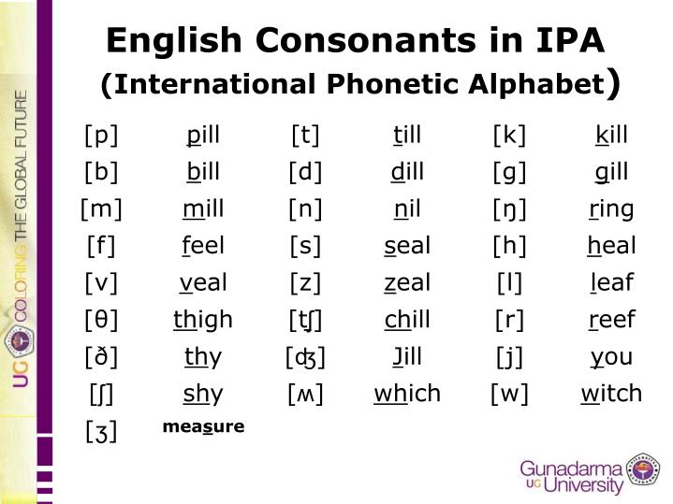
There are 21 consonant letters in the written alphabet (B, C, D, F, G, H, J, K, L, M, N, P, Q, R, S, T, V, W, X, Y, Z), and there are 24 consonant sounds in most English.

Slide 15
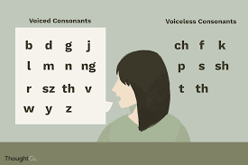
Voiced Consonants
Voiced consonants use our vocal cords to produce their sounds. These are the voiced consonants: B, D, G, J, L, M, N, Ng, R, Sz, Th (as in the word "then"), V, W, Y, and Z:

Slide 16
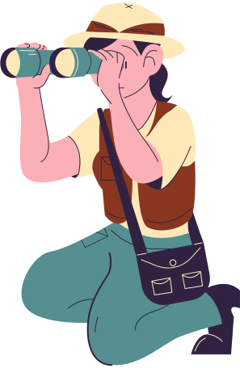
Voiceless Consonants
Voiceless consonants do not use the vocal cords to produce their hard, percussive sounds. These are the voiceless consonants: Ch, F, K, P, S, Sh, T, and Th (as in "thing").

Slide 17
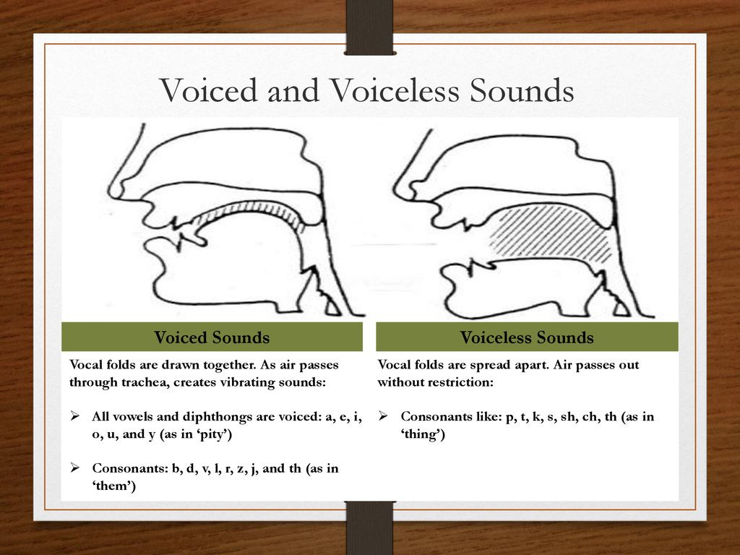

Slide 18
Do the drill:
Th Sounds (/θ/ and /ð/)
1. Thin - This
2. Thunder - Thirsty
3. Thought - Thousand
4. Threshold - Thorough
5. Theather - Therapist
V and W Sounds (/v/ and /w/)
1. Vase - Face
2. Wave - Waver
3. Vocation - Vacation
4. Worthy - Vortex
5. Vine - Wine

Slide 19
Do the drill:
Sh and Ch Sounds (/ʃ/ and /tʃ/)
1. Shoe - Chew
2. Shadow - Chadow
3. Shiver - Quiver
4. Chase - Chaste
5. Shout - Out
S and Z Sounds (/s/ and /z/)
1. Success - Suspect
2. Busy - Buzzy
3. Sauce - Souse
4. Sizzle - Fizzle
5. Season - Reason

Slide 20
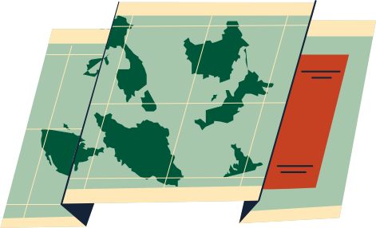
Thank you!

